Slide 1

Introduction to Strimzi
Mateusz Dymiński

Slide 2
Strimzi
What are the problems which Strimzi solves
Definition
Concept
Examples

Slide 3
What are the problems which Strimzi solves
Kafka upgrade
Initial deployment
Manage ZooKeeper
Replacing brokers
Topic partition rebalancing
Decommissioning or adding brokers

Slide 4
Strimzi
An operator-based Kafka on Kubernetes project

Slide 5
Strimzi
Strimzi is an open source operator-based Apache Kafka project for Kubernetes and OpenShif
Announced Feb 25th, 2018
Evolved from non-operator project known as Barnabas by Paolo Patierno, Red Hat
Part of Red Hat Developer Program
“Streams” component of Red Hat AMQ, a commercial product of messaging technologies by Red Hat

Slide 6
Strimzi
Project details:
Apache Kafka project for Kubernetes and OpenShift
Licensed under Apache License 2.0
Web site: http://strimzi.io/
GitHub: https://github.com/strimzi
Slack: strimzi.slack.com
Mailing list: strimzi@redhat.com
Twitter: @strimziio

Slide 7
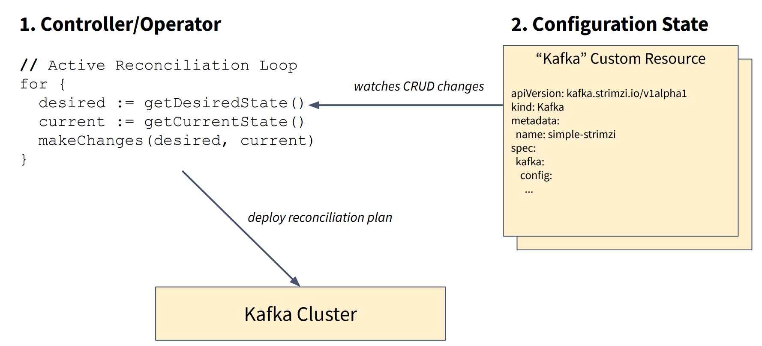
Strimzi – Operator Pattern
Source: https://www.slideshare.net/Lightbend/running-kafka-on-kubernetes-with-strimzi-for-realtime-streaming-applications

Slide 8
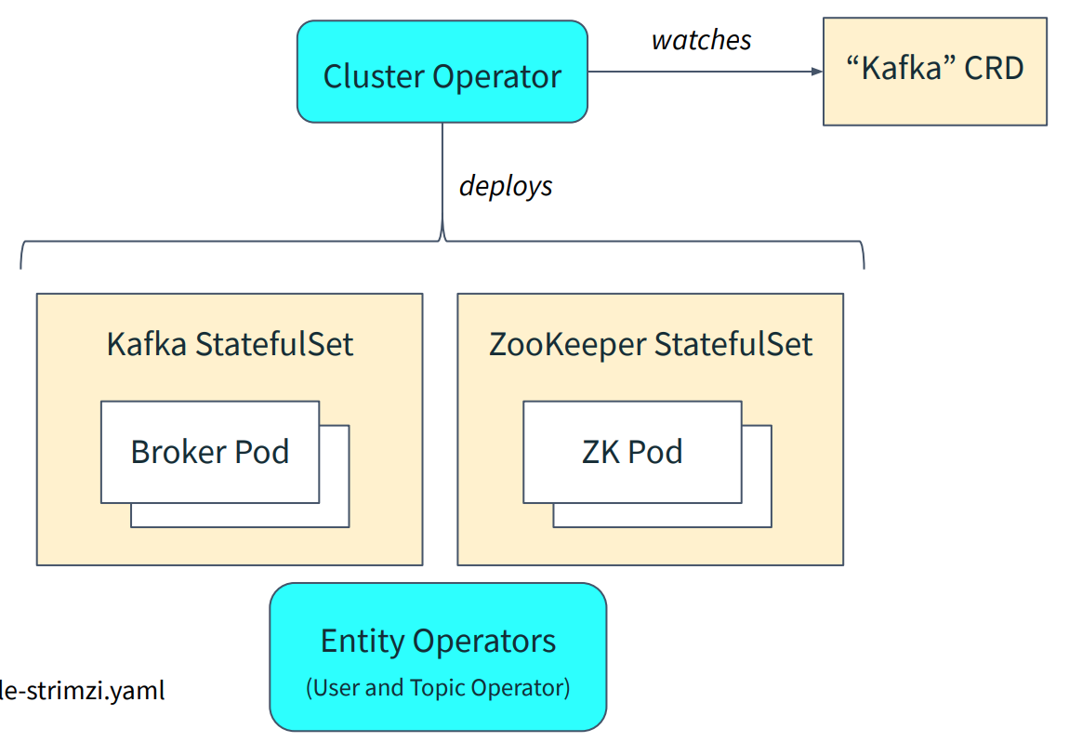
Strimzi – Cluster Operator
Source: https://www.slideshare.net/Lightbend/running-kafka-on-kubernetes-with-strimzi-for-realtime-streaming-applications

Slide 9
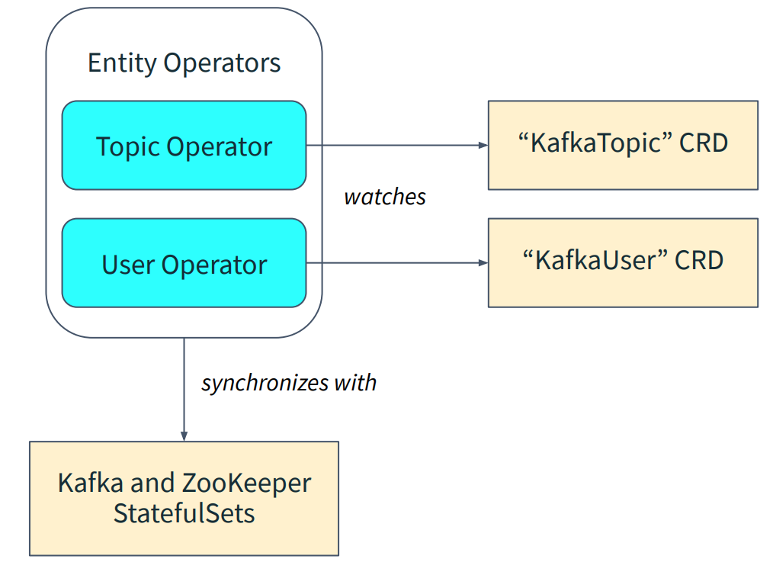
Strimzi – User and Topic Operators
Source: https://www.slideshare.net/Lightbend/running-kafka-on-kubernetes-with-strimzi-for-realtime-streaming-applications

Slide 10
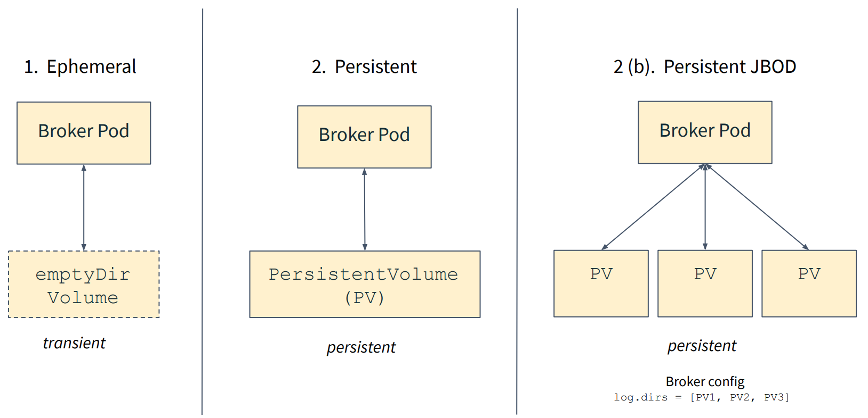
Strimzi – Storage Modes
Source: https://www.slideshare.net/Lightbend/running-kafka-on-kubernetes-with-strimzi-for-realtime-streaming-applications

Slide 11
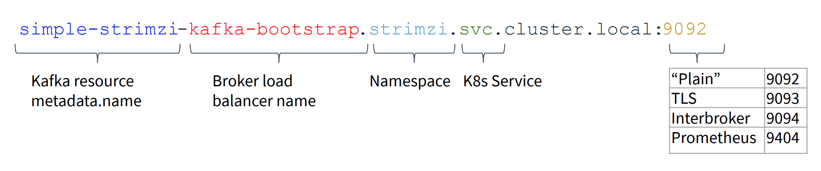
Strimzi – Connecting Clients
Source: https://www.slideshare.net/Lightbend/running-kafka-on-kubernetes-with-strimzi-for-realtime-streaming-applications

Slide 12

Exercise 1 Install Kafka

Slide 13
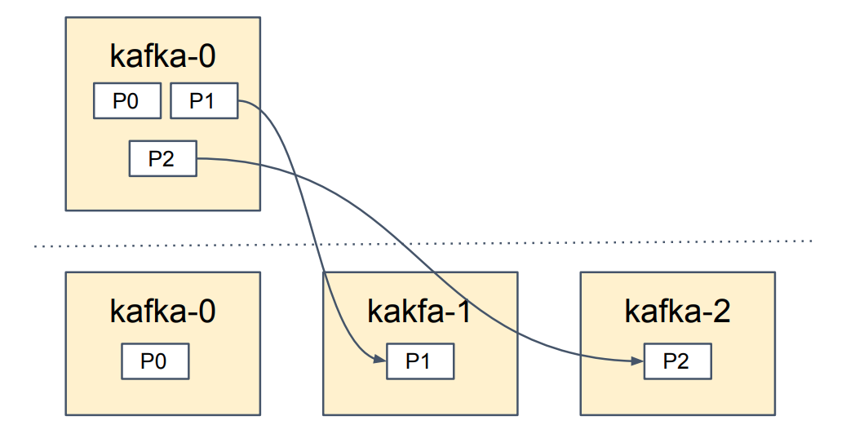
Scaling Brokers Up
Increase replica count spec.kafka.replicas
Reassign partitions: ./bin/kafka-reassign-partitions.sh
Source: https://www.slideshare.net/Lightbend/running-kafka-on-kubernetes-with-strimzi-for-realtime-streaming-applications

Slide 14
Exercise 2 Scaling Kafka Brokers

Slide 15
Rolling Configuration Update
Rolling Configuration Process:
Watched Kafka resource change
Apply new config to Kafka StatefulSet spec
Starting from pod 0, delete the pod and allow the StatefulSet to recreate it
Kafka pod will generate new broker.config
Kafka is started
Wait until the readiness check is good.
Repeat from step 3 for the next pod
Source: https://www.slideshare.net/Lightbend/running-kafka-on-kubernetes-with-strimzi-for-realtime-streaming-applications

Slide 16
Exercise 3 Kafka Configuration

Slide 17
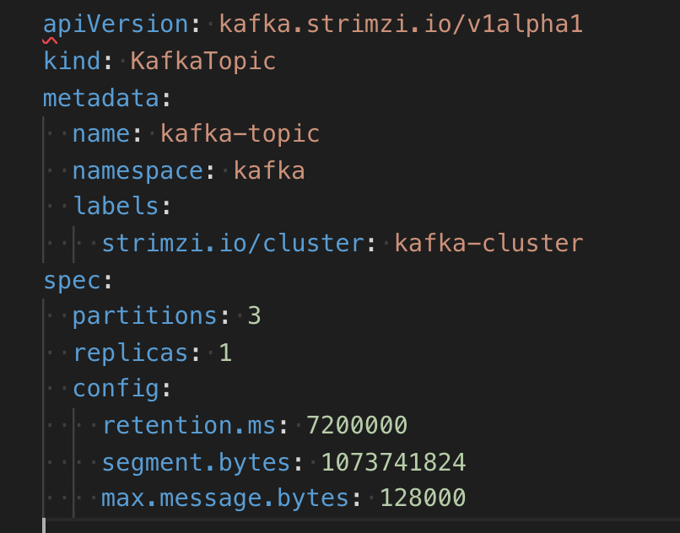
Kafka Topic Configuration
All options: https://kafka.apache.org/documentation/#topicconfigs
We can do that manually:
bin/kafka-configs.sh --zookeeper localhost:2181 --entity-type topics --entity-name kafka-topic --alter --add-config max.message.bytes=128000
Or with Strimzi help

Slide 18
Exercise 4 Topic Configuration

Slide 19

Kafka for HA

Slide 20
Kafka Configuration for High Availability and Consistency
Replication Factor
Preferred Leader Election
Unclean Leader Election
Acknowledgements
Minimum In-sync Replicas
Kafka MirrorMaker

Slide 21

Kafka Monitoring

Slide 22
Kafka Monitoring
Don’t forget to monitor Consumer and Producer metrics

Slide 23
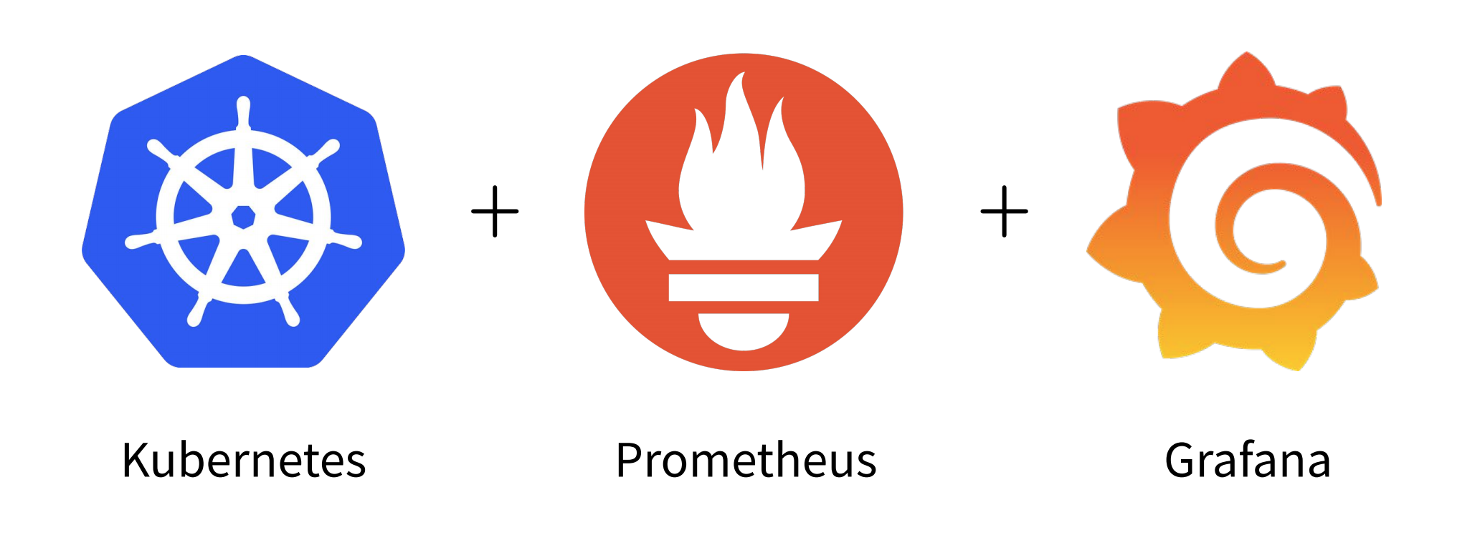
Kafka Monitoring
Source: https://www.slideshare.net/Lightbend/running-kafka-on-kubernetes-with-strimzi-for-realtime-streaming-applications

Slide 24
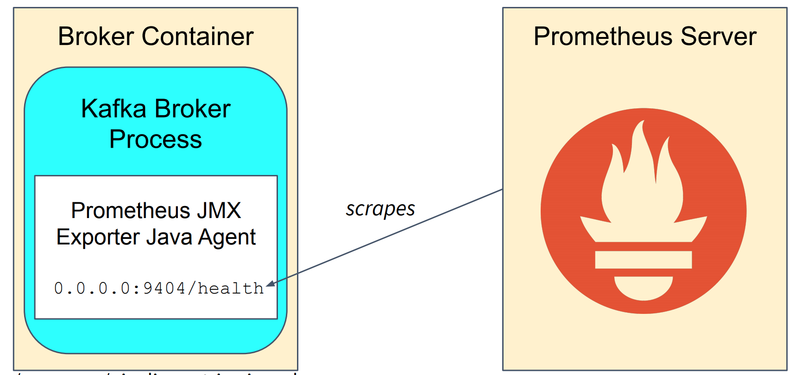
Kafka Monitoring
Strimzi exposes a Prometheus Health Endpoint with Prometheus JMX Exporter
Source: https://www.slideshare.net/Lightbend/running-kafka-on-kubernetes-with-strimzi-for-realtime-streaming-applications

Slide 25
Key Metrics to Monitor
Tree families of metrics:
Kafka Broker metrics
JVM metrics
Host/server metrics

Slide 26
Kafka Monitoring
Don’t forget to monitor Consumer and Producer metrics

Slide 27
Key Metrics to Monitor
Articles:
https://www.datadoghq.com/blog/monitoring-kafka-performance-metrics/

Slide 28

Kafka Troubleshooting and Debugging

Slide 29
Troubleshooting and Debugging

Slide 30
Exercise 5 Setting up Kafka Monitoring

Slide 31
Backup strategy for Kafka
Most popular strategies:
Maintain second Kafka cluster, to which all topics get replicated using MirrorMaker
Dump topics to cloud storage, e.g. using S3 connector.
Problems:

Slide 32
MirrorMaker
Synchronize Kafka topics between clusters
Disaster Recovery
Multi Data Center
Active / Passive cluster
Active / Active cluster

Slide 33
Exercise 6 MirrorMaker

Slide 34

Topic partitions vs consuments

Slide 35
How to choose numer of partitions
Choosing the proper number of partitions for a topic is the key to achieving a high degree of parallelism with respect to writes to and reads and to distribute load. Evenly distributed load over partitions is a key factor to have good throughput (avoid hot spots). Making a good decision requires estimation based on the desired throughput of producers and consumers per partition.

Slide 36
How to choose numer of partitions
So a simple formula could be:
#Partitions = max(N_{P}, N_{C})
where:
N_{P} is the number of required producers determined by calculating: T_{T}/T_{P}
N_{C} is the number of required consumers determined by calculating: T_{T}/T_{C}
T_{T} is the total expected throughput for our system
T_{P} is the max throughput of a single producer to a single partition
T_{C} is the max throughput of a single consumer from a single partition

Slide 37
Key observations:
The number of partitions can be specified at topic creation time or later.
Increasing the number of partitions also affects the number of open file descriptors. So make sure you set file descriptor limit properly.
Reassigning partitions can be very expensive, and therefore it's better to over- than under-provision.
Changing the number of partitions that are based on keys is challenging

Slide 38
Key observations:
Reducing the number of partitions is not currently supported. Instead, create a new a topic with a lower number of partitions and copy over existing data.
Metadata about partitions are stored in ZooKeeper in the form of znodes. Having a large number of partitions has effects on ZooKeeper and on client resources:
You should not have more than 4000 partitions per broker and not more than 200,000 partitions in a cluster

Slide 39
Best practicies:
Unless you have architectural needs that require you to do otherwise, use random partitioning when writing to topics.
Understand the data rate of your partitions to ensure you have the correct retention space.

Slide 40

Thanks!

